Slide 1

Developing a Network Design for a Smart Airport Using Cisco Packet Tracer The fast-changing world is evolving towards automation rapidly every day, and a good network system is inevitable anywhere to properly manage an automated system.
Vivek Kumar Gupta(PGD22DC026)
Arjun Vaibhav Srivastava(PGD22DC005)

Slide 2
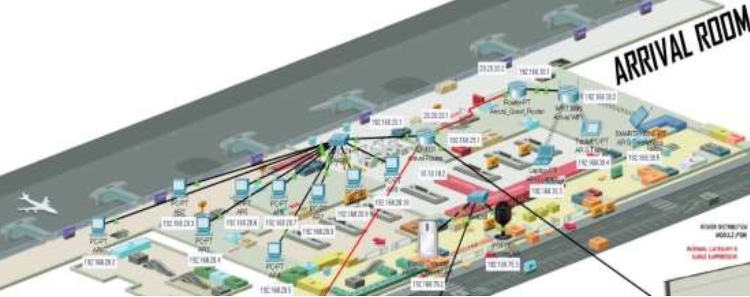
Introduction
The research paper presents a prototype network design for an airport, focusing on faster data transmission and secured network connections.
The study aims to address the challenges of data transmission and security in airport networks.

Slide 3
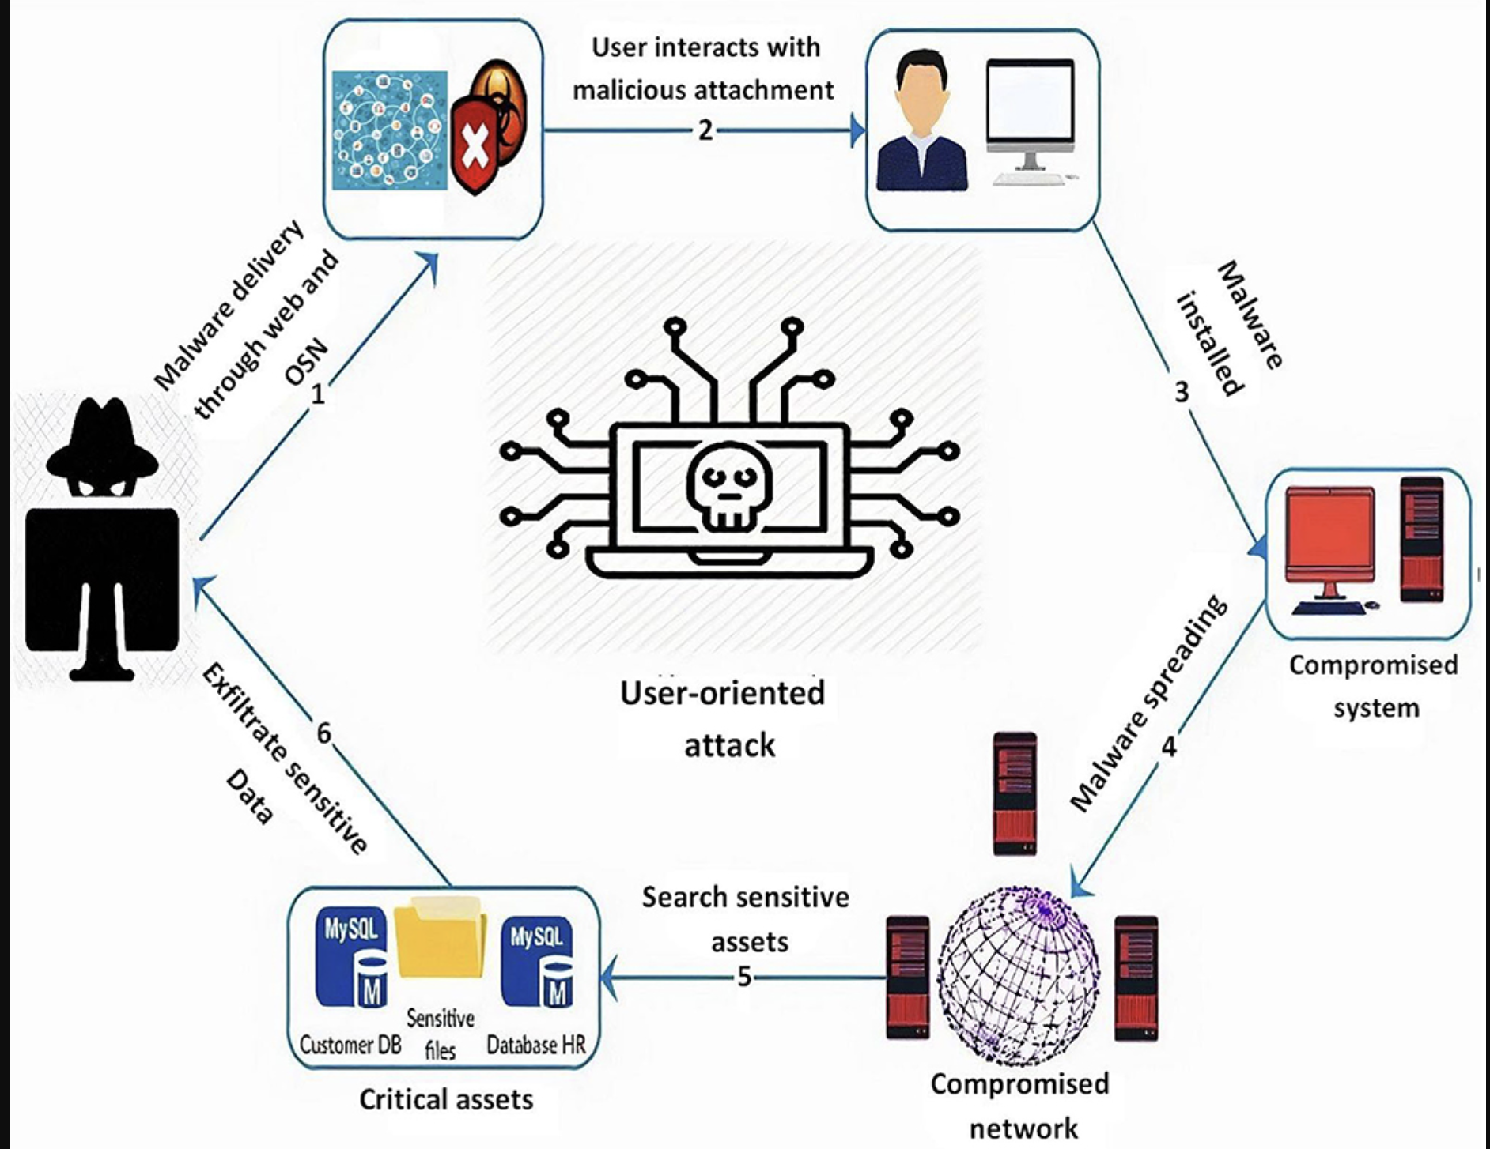
Problem Statement
The current scenario lacks efficient data transmission and secure network connections in airport environments.
Unwanted data transmission poses a significant risk to network operations and security.

Slide 4
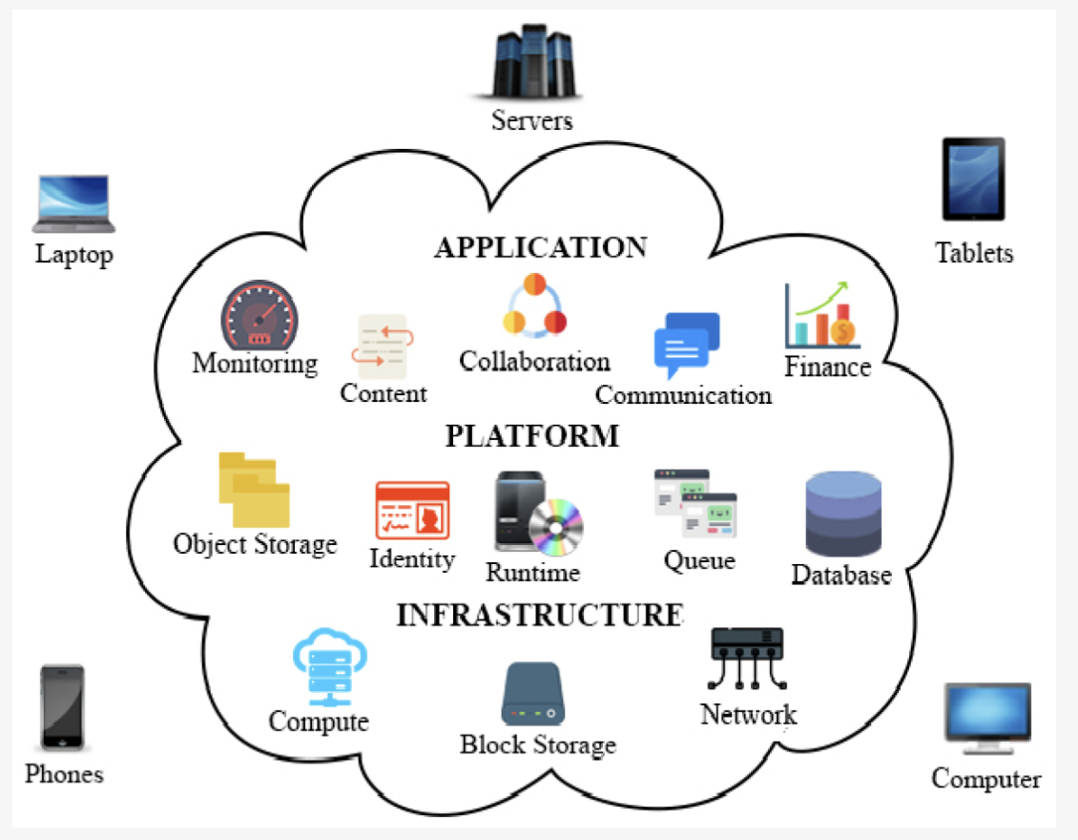
Motivation
The researchers were motivated by the need for a network design that ensures smooth connectivity and secure operations in airports.
The study aims to improve the overall efficiency, reliability, and security of data transmission within airport networks.

Slide 5
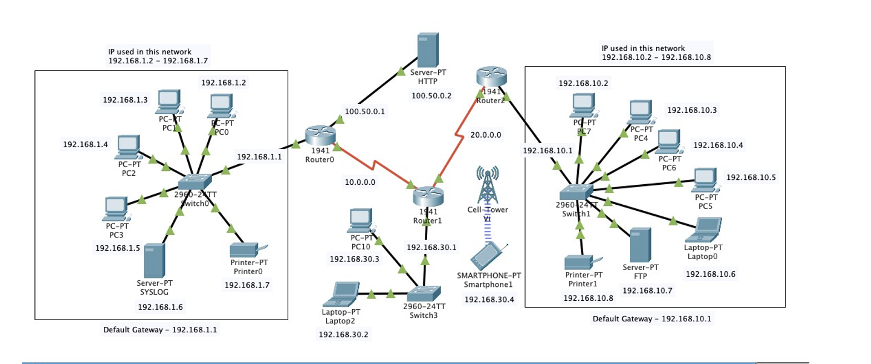
Network Architecture
The network architecture for the airport includes servers, devices, and interconnections.
Data from air control, arrival, and departure rooms are collected and stored within the network.

Slide 6
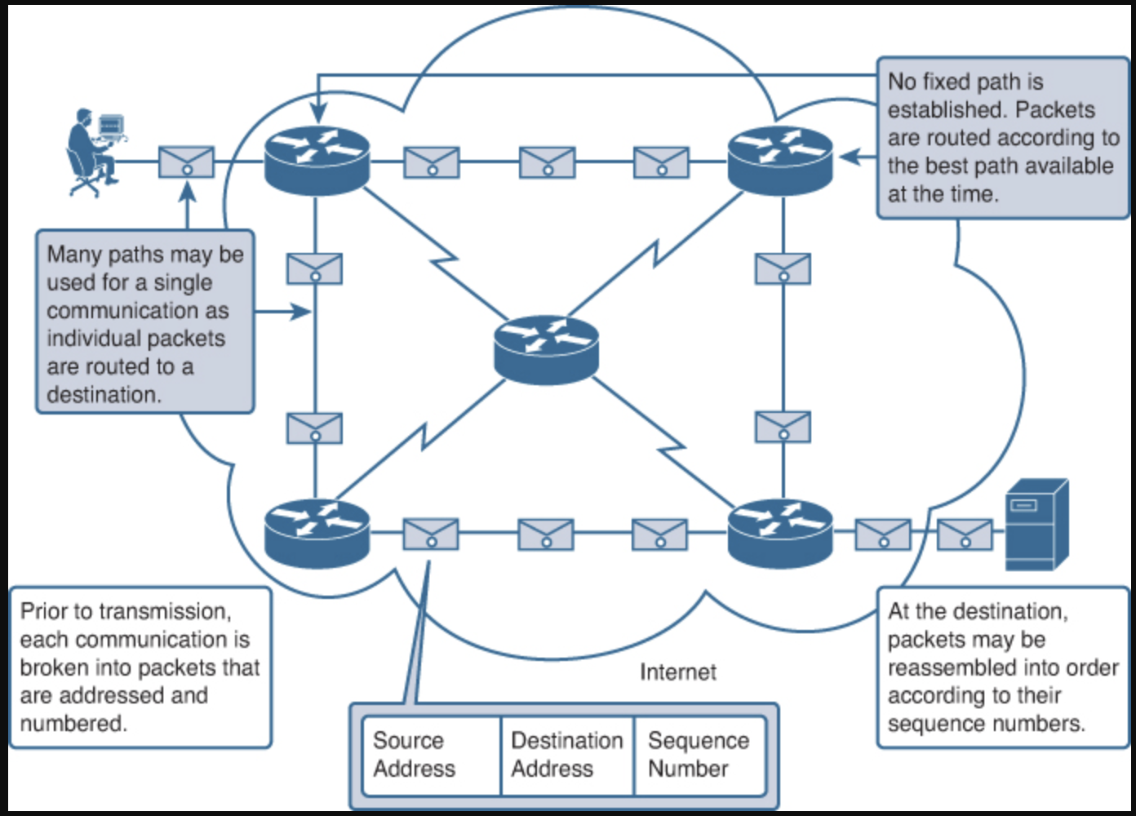
Methodology
The research employed a real-time simulation mode available in Cisco Packet Tracer to develop and test the prototype network design.
The network design focused on establishing secure connections and optimizing data transmission speed.

Slide 7
Protocol Used
Spanning Tree Protocol (STP): STP is used to prevent loops and ensure network redundancy by selecting a single path for data transmission. It helps in maintaining a stable network topology and avoiding packet collisions.
VLAN Trunking Protocol (VTP): VTP simplifies VLAN configuration by allowing the automatic propagation of VLAN information across switches in the network. It enables efficient management and scalability of VLANs in the airport network.
Virtual Router Redundancy Protocol (VRRP): VRRP provides redundancy for default gateway addresses, ensuring high availability in case of router failures. It allows for seamless failover and load balancing between routers in the network.

Slide 8
Protocol Used
Secure Shell (SSH): SSH is a cryptographic network protocol that provides secure remote access to network devices. It ensures encrypted communication and prevents unauthorized access to the network devices.
Virtual Private Network (VPN): VPNs enable secure communication between remote locations or users by encrypting the data transmitted over public networks. Implementing VPN protocols such as IPsec or SSL/TLS in the network design can enhance the security of data transmission.
Access Control Lists (ACLs): ACLs are used to filter network traffic based on specific criteria, such as source/destination IP addresses, protocols, or port numbers. By configuring ACLs, you can control the flow of data and prevent unwanted data transmission in the network.

Slide 9
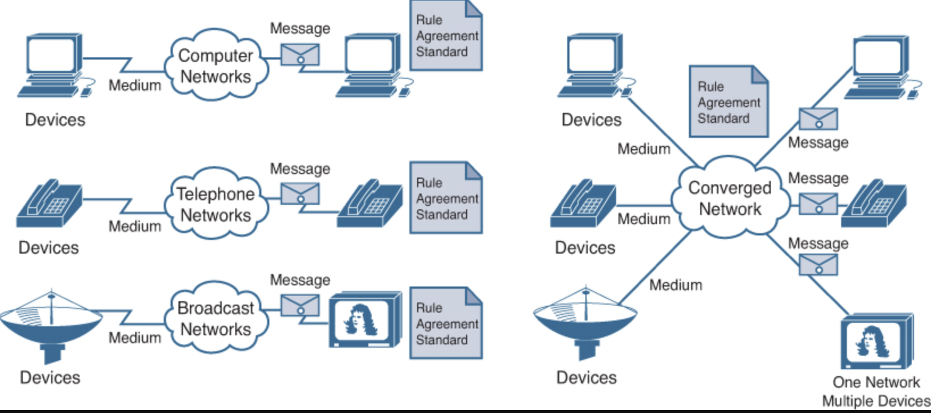
Outcomes
The prototype network design successfully achieved faster data transmission and secured network connections.
The implementation ensured successful connectivity among all devices in the network system.

Slide 10

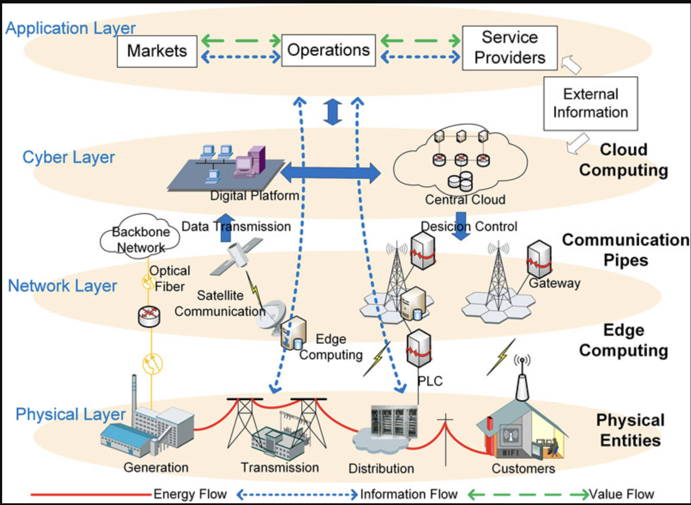
Future Work:
The research highlighted the importance of considering security measures and protocols in airport network designs.
Future work could focus on expanding the network system's capabilities, scalability, and incorporating emerging technologies for improved performance and security.

Slide 11
Thank you

